Slide 1
CS6451: Advanced Software Architecture
Lect L: SOLID and Martin’s Metrics
J.J. Collins
Dept. of CSIS

Slide 2
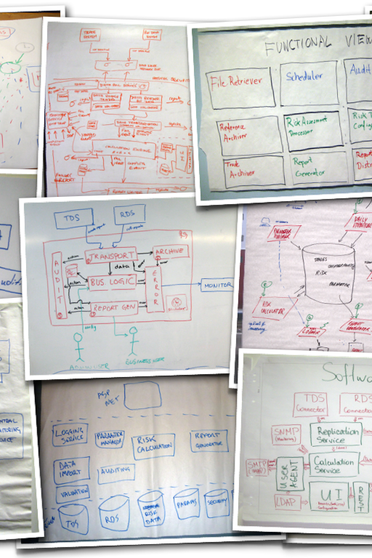
Objectives
SOLID
Use a software metric to evaluate the quality of an OO implementation
Where the metric is architectural.
Based upon Robert C. Martin. Agile Software Development: Principles, Patterns, and Practices. Prentice Hall, 2002
Advanced Software Design
© www.infoq.com

Slide 3

Part 1
SOLID
Advanced Software Design

Slide 4
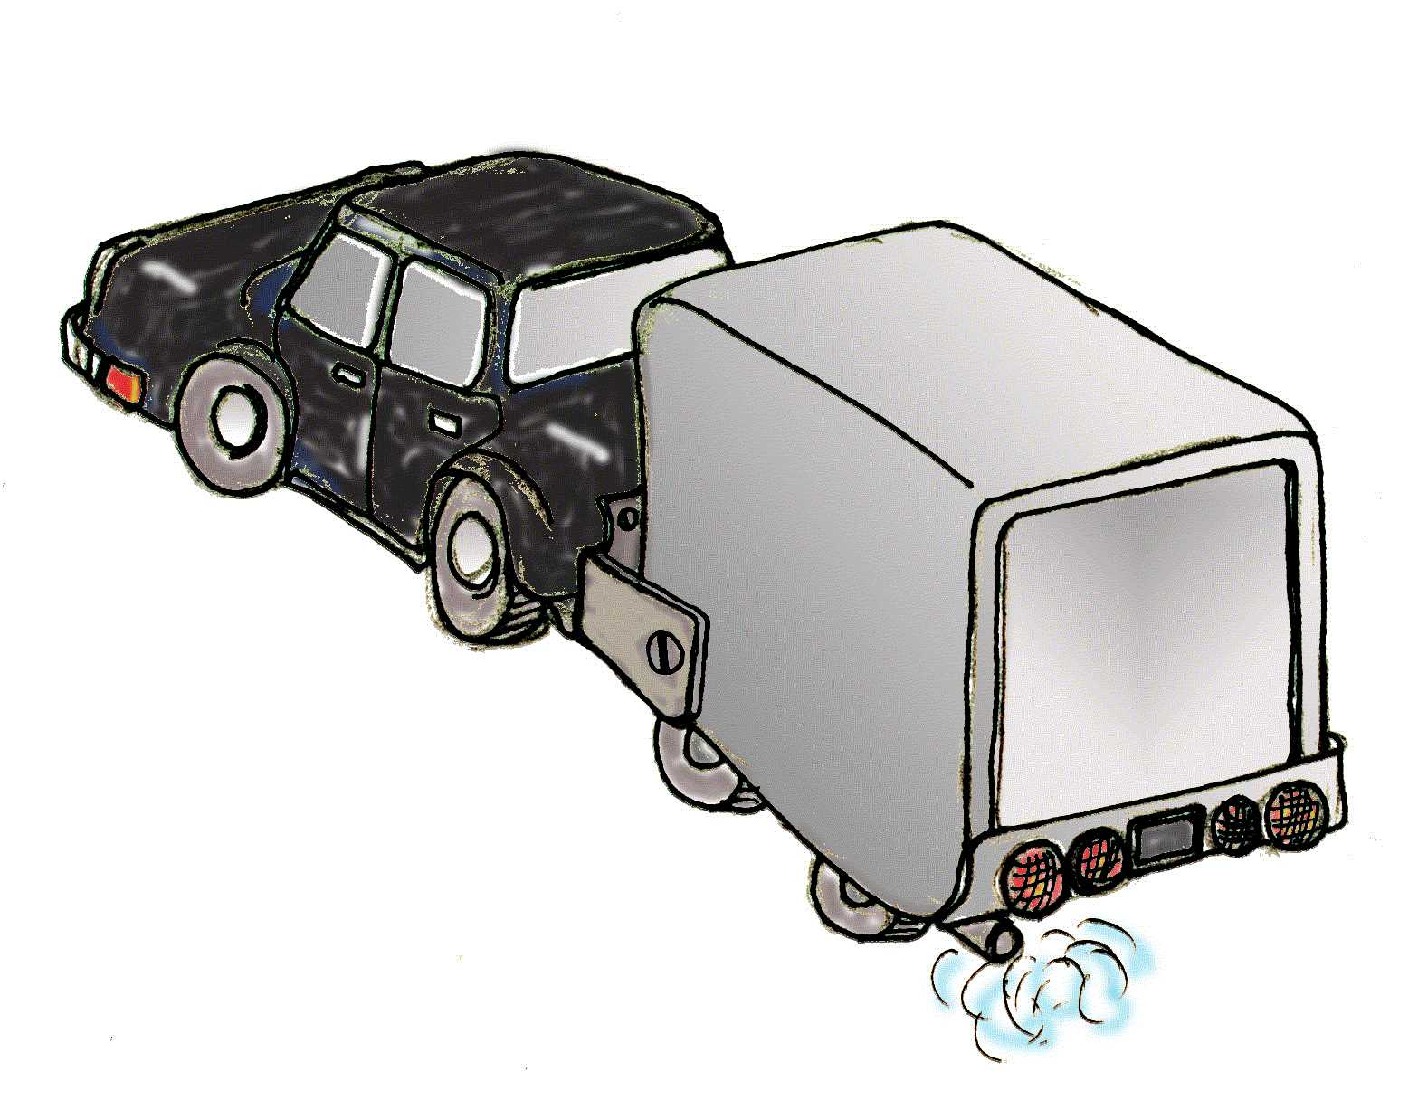
The Trailer
The Trailer
As interdependencies increase, reusability and maintainability decrease.
Dependency Management
Coupling and cohesion are the eternal concerns of software development that impact DM
One can say that OO is just a set of tools and techniques for Dependency Management

Slide 5
7 Deadly Sins of Design
Rigidity – make it hard to change
Fragility – make it easy to break
Immobility – make it hard to reuse
Viscosity – make it hard to do the right thing
Needless Complexity – over design
Opacity: difficult to understand
Notes:
Viscosity – easy to change in a design preserving way

Slide 6
Class Design Principles
SRP: The Single Responsibility Principle
OCP: The Open/Closed Principle
LSP: The Liskov Substitution Principle
ISP: The Interface Segregation Principle
DIP: The Dependency Inversion Principle
→ SOLID
Dependency architecture degrades with changing requirements.
Minimise degradation using dependency firewalls.

Slide 7
The Single Responsibility Principle
https://8thlight.com/blog/uncle-bob/2014/05/08/SingleReponsibilityPrinciple.html
A class should have one, and only one, reason to change.

Slide 8
The Single Responsibility Principle
“When you write a software module, you want to make sure that when changes are requested, those changes can only originate from a single person,”
“Or a single tightly coupled group of people representing a single narrowly defined business function.”

Slide 9
Open/Closed Principle (OCP)
A principle which states that we should add new functionality by adding new code, not by editing old code.
Defines a lot of the value of OO programming
Abstraction is the key
Attributed to Betrand Meyer
Notes:
This is the “mother of all design principles”. It states that software should be, well, soft. It should be easy to introduce certain kinds of changes -- those that we could anticipate.

Slide 10
OCP: Abstraction is Key
Abstraction is the most important word in OOD
Client/Server relationships are “open”
Changes to servers cause changes to clients
Abstract servers “close” clients to changes in implementation.
Key principle in all middleware platforms
Notes:
This effect is also the trick that makes C “function prototypes” useful. By depending on abstractions, we have greater freedom to change implementations. The C version works at link-time, but the OO version actually works at runtime also (polymorphism).
Notice that what happened above is a splitting of the server into an abstract, reliable part, and a concrete changeable part.
If a system is built on this principle, then a certain set of changes may be built by adding concrete implementations of classes without affecting the clients of their abstract interfaces.
This is also an important part of COM and CORBA.

Slide 11
OCP: Abstraction is Key
Excessive component dependencies are bad!
Key architecture issue
  Identifying components that may change
  Reduce direct dependencies on these components
Creates more modifiable systems
C1
C2
C3
C4
C1
C2
C3
C4
AL
Third Party
Component
Third Party
Component
Diagram Key
Component
Dependency
C

Slide 12
OCP: The Shape Example
Procedural (not closed) implementation
OO (closed) implementation

Slide 13
OCP: Procedural (Open) version
Shape.h
DrawAllShapes.c
enum ShapeType {circle, square};
struct Shape
{enum ShapeType itsType;};
#include <Shape.h>
#include <Circle.h>
#include <Square.h>
typedef struct Shape* ShapePtr;
void
DrawAllShapes(ShapePtr list[], int n)
{
int i;
for( i=0; i< n, i++ )
{
ShapePtr s = list[i];
switch ( s->itsType )
{
case square:
DrawSquare((struct Square*)s);
break;
case circle:
DrawCircle((struct Circle*)s);
break;
}
}
}
Circle.h
struct Circle
{
enum ShapeType itsType;
double itsRadius;
Point itsCenter;
};
void DrawCircle(struct Circle*)
Square.h
struct Square
{
enum ShapeType itsType;
double itsSide;
Point itsTopLeft;
};
void DrawSquare(struct Square*)
Uses Run Time Type Information (RTTI) → bad code smell!

Slide 14
OCP: What is wrong with the code?
DrawAllShapes is not closed.
  Switch/case tend to recur in diverse places.
  If we add a shape, we add to the switch/case
  All switch/case statements must be found and edited.
  Switch/Case statements are seldom this tidy
  When we add to the enum, we must rebuild everything
Saw the same phenomenon in Folwers Movie Rental System example
Notes:
In many systems, we can see the same structure, without even having separate functions for the different shapes -- it’s all in the switch-case statements.
Most common edit error? Probably forgetting the “break”.
If you know where all the switch/case statements are, by the time you get done editing them there will probably be another. It will probably be checked in after you check yours in, by someone with no knowledge of your changes.
We suggest that switch/case statements are a lot like cockroaches. If you see one, you’ve got dozens more hiding in dark corners and crevices.

Slide 15
OCP: A Closed Implementation
Circle.h
Shape.h
Class Circle: public Shape
{
public:
virtual void Draw() const;
};
Class Shape
{
public:
virtual void Draw() const =0;
};
DrawAllShapes.cpp
Square.h
#include <Shape.h>
void
DrawAllShapes(Shape* list[],int n)
{
for(int i=0; i< n; i++)
list[i]->draw();
}
Class Square: public Shape
{
public:
virtual void Draw() const;
};
Notes:
Here, DrawAllShapes is closed against modifications, in that adding a new shape does not require making any edits to DrawAllShapes.cpp.
Notice that there is only a dependency on shape.h. The DrawAllShapes routine doesn’t even know anything about circles and squares, but it works just fine anyway.
On comp.object, one contributor said that abstraction is “whittling away all of the reality you can stand to do without”. Here, we find that DrawAllShapes needs very little of the definition of a shape, and none of the details, to invoke the appropriate functionality.

Slide 16
OCP: Strategic Closure
No program is 100% closed. Closure Against What?
  Closure is strategic. You have to choose which changes to isolate against.
  What if we have to draw all circles first? Now DrawAllShapes must be edited (or we have to hack something)
Opened Where?
  Somewhere, someone has to instantiate the individual shapes.
  It’s best if we can keep the dependencies confined
  Factory Methods → Dependency Firewall
Isolate categories of changes, not specific changes
  Schema changes
  Sensor hardware changes
  Data store technology
OCP → Design for Change.
OCP combats fragility
  No changes to working code
Notes:
You have to choose carefully what changes you will isolate the program from. You want to choose likely kinds of change, for which the cost of changes would be greater than the cost of isolation.
This requires experience, along with domain and technical knowledge. It requires a well-fed intuition.
Some code cannot help but be encumbered. The goal in that case is to do damage control, and focus changes into the simplest-possible routines which are easily discarded.
After all, eventually the rubber must meet the road.

Slide 17
Liskov Substitution Principle
Derived classes must be usable through the base class interface, without the need for the user to know the difference.
All derived classes must be substitutable for their base classes
This principle guides us in the creation of abstractions.
Notes:
Barbara Liskov works at MIT and is very influential in distributed computing circles. You can find some of her papers online at http://www.pmg.lcs.mit.edu/barbara_liskov.html. You can find more information on her Behavioral Notion of Subtyping online.

Slide 18
Square/Rectangle
A square is-a rectangle, right? So lets consider Square as a subtype of Rectangle.
We can make it work:
Uh, oh. This
doesn’t quite seem to fit
void Square::SetWidth(double w)
{
width = w;
height = w;
}
void Square::SetHeight(double h)
{
width = h;
height = h;
}

Slide 19
LSP
void unitTest(Rectangle r) {
int height = 5;
int width = 10;
r.setHeight(height)
r.setWidth(width)
assert(r.getHeight() == height);
assert(r.getWidth() == width);
}
What happens when a square is given to unitTest() ?
Failure

Slide 20
Substitution… denied!
It is reasonable for users of a rectangle to expect that height and width may change independently.
These expectations are preconditions and postconditions
  Bertrand Meyer calls it “Design by Contract”
  Post condition contract for rectangle is
    width = new Width
    height = old height
Square violates Rectangle’s contract
Notes:
This gives a new concept to us: the expectations of the users of an interface are the ones who must be satisfied by each new derivative. This means that inheritance is not just a relationship between two classes, but between the derivative and all of the users of the base.
Fulfilling the prototypes for the messages is not enough to fool the clients. If a user of ‘rectangle’ can reasonably assume from the interface that the X and Y can be changed independently, and then it receives a square, it will not receive the anticipated service. Instead, all such clients will have to be modified to first check to see if the rectangle is a square rectangle before operating on it.
The problem is no better if rectangle derives from square.
Not to fear, though. There are ways to share code other than inheritance. You don’t have to inherit to share code, and you don’t have to inherit in order to represent similarities in structure.
What happens to be true in mathematics is out of context in our app. In mathematics, things ‘are’. In OO, things ‘do’. It’s not physical structure, but expectations and behavior that matter in OO designs.
“square is a rectangle” is true, but not very useful.

Slide 21
Liskov Substitution Principle (cont.)
A client of rectangle expects height and width to be changed independently
  void setAspectRatio( Rectange* r, double ratio );
By deriving Square from Rectangle, we are allowing someone to set the aspect ratio of a Square !
We can still make it work
  if ( typeid(r) == typeid(Rectangle) )
  Violates Open/Closed Principle !

Slide 22
Liskov Substitution Principle (cont.)
Design by Contract
  Bertrand Meyer
  Preconditions, postconditions, invariants
Rectangle's postconditions for setWidth()
  width = newWidth
  length = oldLength
Square can require no more of clients, nor promise any less
  Doesn't maintain invariant of length
  Violates the contract
Violating LSP is tantamount to violating the OCP

Slide 23
Liskov Substitution Principle (cont.)
Demand no more, promise no less
Precondition cannot be stronger than the precondition in the base class.
Postcondition cannot be weaker than the poscondition in the base class
“Unfortunately, LSP violations are difficult to detect until it is too late. In the Circle/Ellipse case, everything worked fine until some client came along and discovered that the implicit contract had been violated.”

Slide 24
Dependency Inversion Principle
Details should depend on abstractions. Abstractions should not depend on details.
V.
If OCP states the goal of architecture, DIP states the primary mechanism.
Notes:
a.k.a Depend on abstractions principle
This is a matter of focus. We are more interested in the dependencies between objects rather objects themselves.
Don’t do this blindly

Slide 25
First Version
All designs start well
void copy(void)
{
int ch;
while( (ch=ReadKeyboard()) != EOF)
WritePrinter(ch);
}
We sometimes want to read from magnetic tape reader.
We could put a parameter in the call, but we have hundreds of users already!
No big deal, this is just an exception… we can make it work.
“Why the Future of Data Storage is (Still) Magnetic Tape” IEEE Sectrum 2018
https://spectrum.ieee.org/why-the-future-of-data-storage-is-still-magnetic-tape
Notes:
This is an intuitive design, it is concise, and you can tell that the bottom two modules (ReadKeyboard and WritePrinter) are probably reusable.

Slide 26
Second Version Design
Bool tapeReader = false; // remember to clear
void copy(void)
{
int ch;
while( (ch=tapeReader ? ReadTape() : ReadKeyboard()) != EOF)
WritePrinter(ch);
}
Notes:
We depend on the new users of the module, the paper tape folks, to set and unset the flag. They can’t just call the routine. There is more dependency on documentation and memorization.
There is an unwanted side-effect here. Everyone using the copy routine must now link in the paper tape reader routine whether they use it or not. But at least they don’t have to change any of their code.
The old users call the routine the old way, the new users have a little extra protocol to remember.

Slide 27
Third Version
How unexpected! Requirements changed again!
It seems that sometimes we need to write to a tape punch for Braille.
We’ve had this problem before, and just added a flag. Looks like it should work again.
Bool tapeReader = false;
Bool tapePunch = false;
// remember to clear
void copy(void)
{
int ch;
while( (ch=tapeReader ? ReadTape() : ReadKeyboard()) != EOF)
tapePunch ? WritePunch(ch) : WritePrinter(ch);
}
Notes:
Remember that tidy little program we started with? Where did it go?
The trend is clear. Every time the requirements change in this way, we have to edit the code. Every time, link requires more unneeded modules. Every time, the logic is less clear. Every time, there is a chance of accidental error.
Every time, there is more for the callers of the routine defend against. What if one of the flags was left set? Should all callers clear all the flags? There is increasingly more to know in order to use the routine correctly.
Sometimes, simple things refuse to stay simple.

Slide 28
Example of a Good Design
First and only version.
void Copy()
{
int c;
while( (c=getchar()) != EOF)
putchar(c);
}
This isn’t OO is it?
FILE is an abstraction
  It represents some kind of byte stream
  It has many variations
It has methods
  Read, Write, getchar, putchar, etc
  The methods are *dynamically* bound
Notes:
Good means:
Flexible - easy to extend
Not fragile - won’t break when we add new IO devices
Reusable - this code can be reused without change by adding IO devices that work with fgetc and fputc
Low viscosity - costs of development don’t increase sharply with the number of releases.

Slide 29
Rephrased in OO
interface Reader
{ char read(); }
interface Writer
{ void write(char c); }
public class Copy
{
Copy(Reader r, Writer w)
{
itsReader = r;
itsWriter = w;
}
public void copy()
{
int c;
while( (c=itsReader.read()) != EOF )
itsWriter.write(c);
}
private Reader itsReader;
private Writer itsWriter;
}
Notes:
This is far less simple than the original version. This is so that we have greater resilience in the face of foreseeable changes. We can use this small and simple program in many different contexts.
Initially, we’d only implement the keyboard reader and printer writer. We’d have a program that completely and *only* fulfilled its requirements. Everything built was needed.
Later we’d build paper tape readers and writers, when they were needed. If they are never needed, the cost of this version is still not very high. It’s a wager that we are likely to win.
Notice that it is very easy to write common copy() routines that use common streams. But notice also that you never link in any implementations you don’t need.

Slide 30
DIP Implications
Avoid deriving from concrete classes
Avoid associating to concrete classes
Avoid aggregating concrete classes
Avoid dependencies on concrete components
Legitimate reasons to violate
  Creation of objects
    new Circle creates a dependency on concrete class
    localize these dependencies using factories
  Nonvolatile classes
    string, vector, etc.
    providing they are stable
Notes:
If software exists to map a process onto a platform, and is written to requirements, then the only reasons for software to change are changes to requirements or changes to the platform -- which are usually embodied in concrete classes.
Concrete classes, then, are detail-oriented, and subject to a generally higher rate of change than well-defined abstractions.
There are exceptions. Those classes that Meilir Page-Jones calls “foundation domain classes” (int, long, float, list, etc) might be reliable in a given circumstance. We recommend initial distrust, but some of these foundation domain classes are static enough through long use to be somewhat reliable.
Foundation domain objects do sometimes change when porting or accepting upgrades to compilers or platforms. Do be wary. The rules still hold.

Slide 31
Interface Segregation Principle
Sometimes class methods have various groupings.
These classes are used for different purposes.
Not all users rely upon all methods.
This lack of cohesion can cause serious dependency problems
These problems can be refactored away.

Slide 32
Interface Pollution by “collection”
Distinct clients of our class have distinct interface needs.
Notes:
Sometimes there are aspects of a system that are common, but the interfaces to this common aspect are unique to the clients. Error logs are sometimes this way, as are error displays, interfaces to UI devices, databases, etc.
In this arrangement, we are in real trouble.
If we add a fourth client, the interfaces needed to support the fourth client are edited onto the server interface. This causes all three of the existing clients to be recompiled, or perhaps edited. That’s a violation of the OCP.
Also, it could be that the Server needs to modify the Client1Interface in order to better serve Client 1. This is troublesome, because it affects clients 2 and 3.
In dynamically-typed languages, the collection of methods merely defocuses the objects and subtle variations in method names may complicate maintenance. Either way, the situation is uncomfortable.
We need to segregate these interfaces much as we did the interfaces for timers and doors.

Slide 33
A Segregated Example
Notes:
Now changes to interfaces only affect the clients which depend directly on that interface, and the object that implements the interface.
It is also not necessary that the implementations are multiply-inherited and implemented in a single class anymore. The clients are unaware of the detailed implementation, so we can split the server in the future.
By segregating interfaces, we isolate dependent modules from one another. This is good DM, and good OOD.
Yes, we end up with more, smaller classes.

Slide 34
Part 2
The Main Sequence Metric
Advanced Software Design

Slide 35
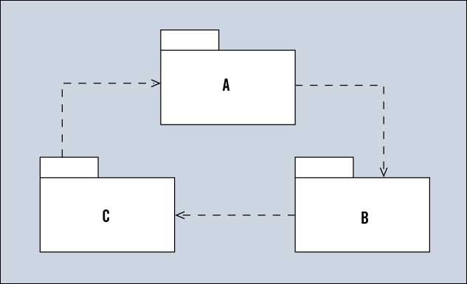
Stability / Martin’s Distance Metric
SOLID → manage dependencies → manage volatility
This cycle of dependencies minimises reuse potential.
None of the individual modules below can be broken out of the system and reused elsewhere.
High on Immobility (one of the 7 deadly sins)

Slide 36

Stability → Acyclic Dependencies Principle (ADP)
This is why good object-oriented designs follow the ADP
Dependencies among modules must be arranged in a Directed Acyclic Graph (DAG).
There can be no cycles of dependencies among modules.
Eliminating dependency cycles among modules requires tool support.
Java programmers can use JDepend to detect cycles in their module structures
Advanced Software Design
© www.infoq.com

Slide 37
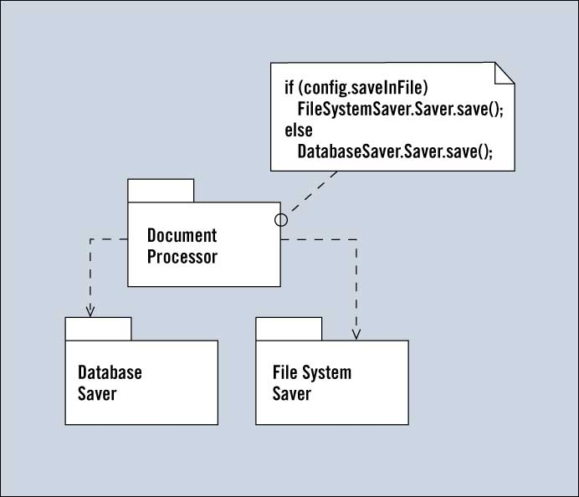
Stability
These modules aren't independently deployable.
The DocumentProcessor module depends on both kinds of savers, and uses an "if" statement to choose between the two.
A better design would eliminate the "if" statement and use polymorphism.
  Using state / strategy pattern

Slide 38
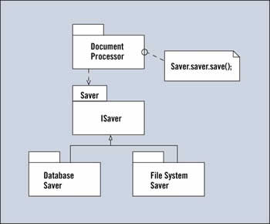
Stability
DatabaseSaver and FileSystemSaver contain classes that implement the ISaver interface.
The DocumentProcessor module uses the ISaver interface.
DocumentProcessor has no direct dependence on DatabaseSaver or FileSystemSaver.
  Abstract Client pattern
  Basis for many design patterns

Slide 39
Stability
Separates the modules based on their different volatilities.
DatabaseSaver and FileSystemSaver represent volatile part of the design,
  And there will/may be many more kinds of Savers in the future.
The operation of these savers can change without affecting any other part of the system.
If the DocumentProcessor is volatile, it changes for very different reasons than do the Savers.
  So this design separates two different kinds of volatility.
The Saver module is much more stable than any of the others,
  This relative lack of volatility allows the others to depend on it.
  They're safe from each others' changes because Saver is interposed between them.

Slide 40
Stability
This leads us to a simple rule, the Common Closure Principle (CCP):
  First, code with different kinds of volatility should be placed in different modules.
  Second, modules should not depend on other modules that are more volatile than they are. Rather, they should depend on less volatile ones.
Presented frequently with two other principles
  The Release Reuse Equivalency Principle
  The Common Reuse Principle

Slide 41
Stability
Volatility is difficult to measure.
However, we can quantify something that's closely related
Martin calls it stability.
A coin lying flat is stable, an upright one is instable.
Stability in terms of a module, is the measure of how difficult a module is to change.
Modules that are difficult to change are likely to be involatile, and vice versa.
Good design ensures that volatile code goes into instable modules and involatile code goes into stable modules.

Slide 42
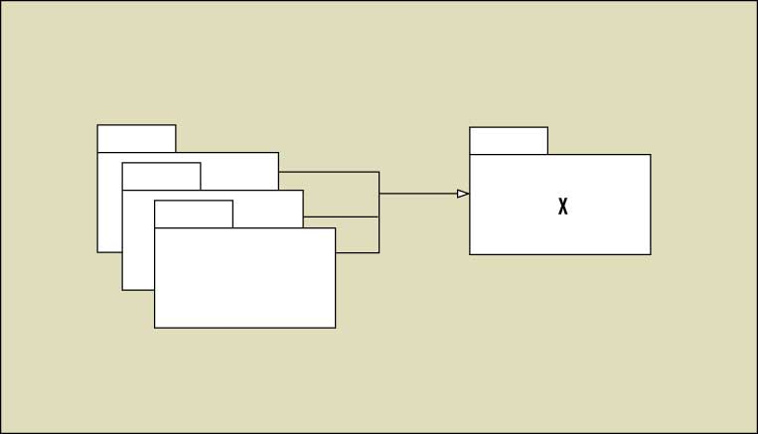
Stability
Is Module X stable or instable?
It has many other modules depending upon it
  If it's changed, all those other modules may need to be changed, as well.
The more incoming dependencies a module has, the harder that module is to change, and thus, the more stable it is.

Slide 43
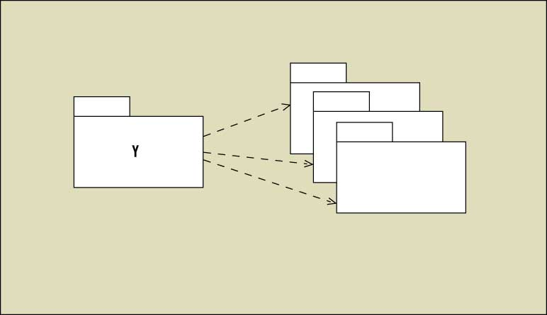
Stability
Now consider Module Y.
This module is easy to change because no other module depends upon it. It is instable.
Moreover, module Y has many reasons to change because it depends on many other modules

Slide 44
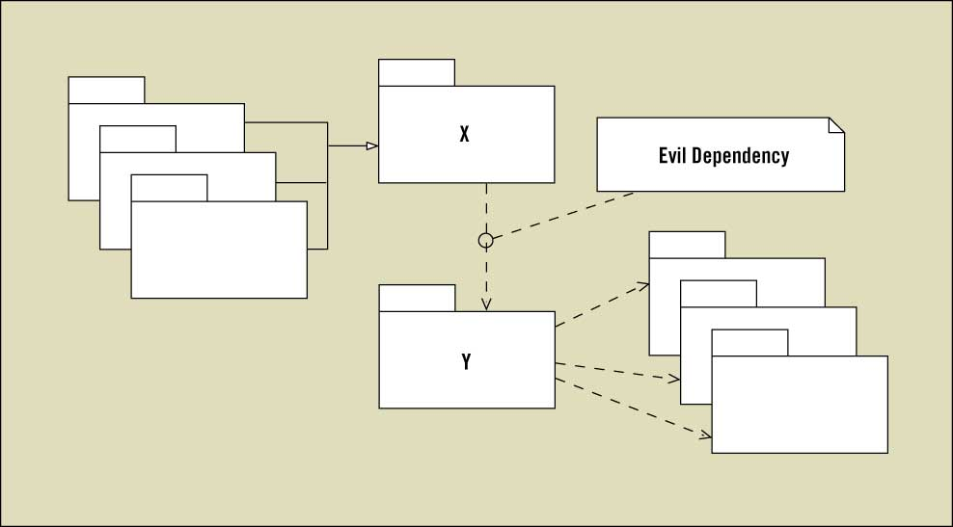
Stability
Good design tells us that we should put our volatile code into modules like Y and our involatile code into modules like X.
Good design also demands that modules like X should never depend upon modules like Y.
Consider what would happen if the author of X mentioned the name of some class in module Y!

Slide 45
Stability
The maintenance characteristics of a module can be ruined simply by mentioning its name.
No code in module Y has changed, yet Y has suddenly been made difficult to change, even though the designers loaded Y with code that was volatile!
Now, all that volatile code is stuck in a module that's stable.
→ Error Condition!

Slide 46
Stability
We can prevent this by measuring each module's stability and enforcing a simple rule
- the Stable Dependencies Principle (SDP)
  No module should depend on a module that is less stable than it is.
We measure the stability of a module by counting dependencies.
  Ce (efferent coupling / fan-out) the number of modules that this module depends upon.
  Ca (afferent coupling / fan-in) the number of modules that depend upon this module.
Given these two metrics, we can calculate instability as follows:
I (Instability) = Ce / (Ca + Ce)

Slide 47
Stability
I is a metric in the range [0,1].
  If I is 0, the module is very stable.
  If I is 1, the module is instable.
  The values between 1 and 0 represent varying degrees of stability.
Apply the SDP rule by making sure that every dependency between modules points in the direction of decreasing Instability
  That is, each module depends upon modules that are more stable than it is.

Slide 48
Stability
Applying this rule guarantees that some modules will be highly stable, and, by definition, hard to change, leaving us with inflexible modules in our designs.
Modules that are stable aren't necessarily inflexible.
The Open Closed Principle (OCP):
  Modules that are abstract can be extended without alteration.
  Thus, an abstract module can be flexible, even though it's hard to change.

Slide 49
Stability
The Dependency Inversion Principle (DIP)
  Dependencies should point in the direction of abstraction.
To illustrate this, how can we solve the dilemma posed by the dependency between module X and Y (slide 44)?
Module Y contains some class that module X wants to use.
That class belongs in module Y because it shares volatility with the other classes in Y.
How can we get X to use Y and not violate the SDP?
  We create a new module I, which contains an abstract class (or interface) named AC.
  Module X uses this class, and module Y implements it, thus resolving all the issues.
  X no longer depends upon Y.

Slide 50
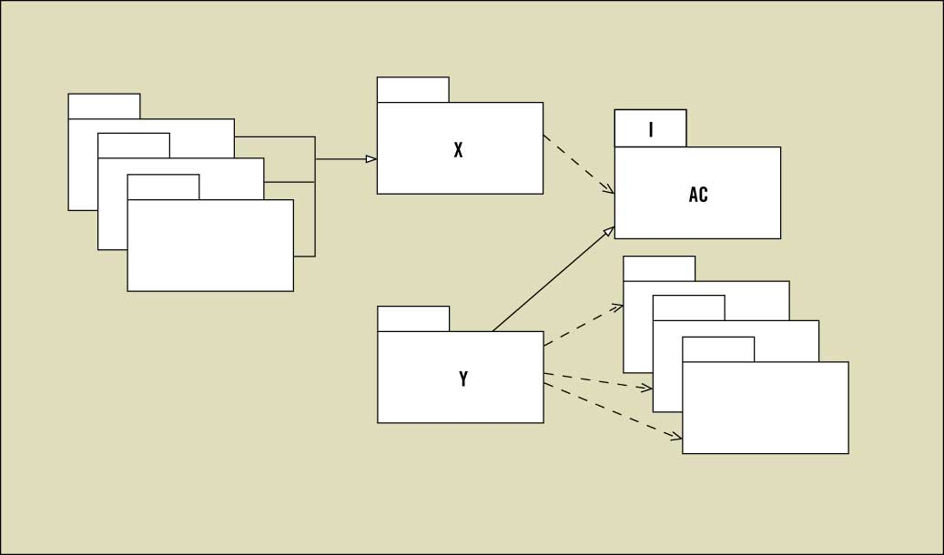
Stability
The volatile code in Y stays in Y.
And both X and Y depend on a module I that is more stable than either of them.
Moreover, both X and Y "depend" in the direction of abstraction.

Slide 51
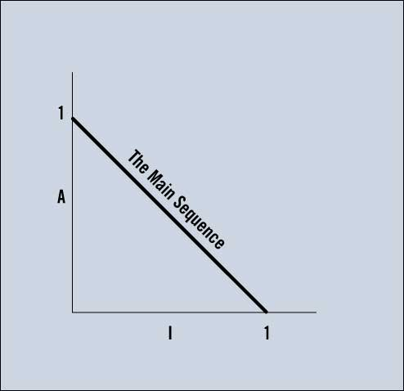
The Main Sequence
Thus, the more stable a module is, the more abstract it should be, → the Stable Abstractions Principle (SAP).
Plot the instability of a module against its abstractness,
  the module should fall close to the line named "The Main Sequence.“
Modules on that line are as abstract as they are stable, or are as concrete as they are instable.

Slide 52
The Main Sequence
A (Abstractness) = Na / Nc, where Na is the number of abstract classes (or interfaces) in the module, and Nc is the number of classes in the module.
This metric falls in the range of [0,1], just as the graph requires. Again, tools like JDepend and HeadWay can calculate this metric.

Slide 53
The Main Sequence
Given a module, how far from the main sequence is it?
This metric D:
D (distance) = |A + I - 1|
Falls in the range of [0,1],
  where 0 means that the module is on the main sequence,
  and 1 means that it's as far from the main sequence as possible.

Slide 54
The Main Sequence
A system that's well designed for independent testability and reuse will generally have its modules clustered around the main sequence,
  with D metrics that are close to zero.
These metrics should never be considered as laws.
  They are, at best, crude indicators of structure.
Some modules will have high D metrics, yet be harmless to the system structure.
And other modules with D metrics very close to zero don't help the system's structure in any way.
Informed interpretation is essential.

Slide 55
The Three Rules
The module structure of a well-designed system should abide by the following tenets:
  It contains no dependency cycles. (ADP)
  Every dependency between modules should terminate on a module whose I metric is less than or equal to the depending module's I metric. (SDP)
  Every dependency between modules should terminate on a module whose A metric is greater than or equal to the depending module's A metric. (SAP)

Slide 56
The Three Rules
Any module with a D metric that is very close to zero (less than .05 [???] or so) will conform closely to points two and three.
Conforming to these three rules will help create systems that comprise independently deployable modules -systems with a high degree of reusability and testability.

Slide 57


Look Up: C&K Metrics
Chidamber, S. R. & Kemerer, C. F. (1994). A Metrics Suite for Object Oriented Design (IEEE Transactions on Software Engineering, Vol. 20, No. 6). http://www.pitt.edu/~ckemerer/CK%20research%20papers/MetricForOOD_ChidamberKemerer94.pdf

